Slide 1

WIFI : TOKOPEDIA EVENT
PASSWORD : Tokopedia@event

Slide 3
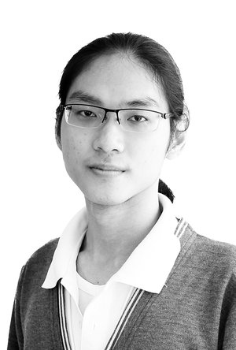
Introduction
Joined Tokopedia since October 2015
One of the first DS in Tokopedia
Taking lead role since July 2016
Responsibility overview: Make it happen, make it better.

Slide 4
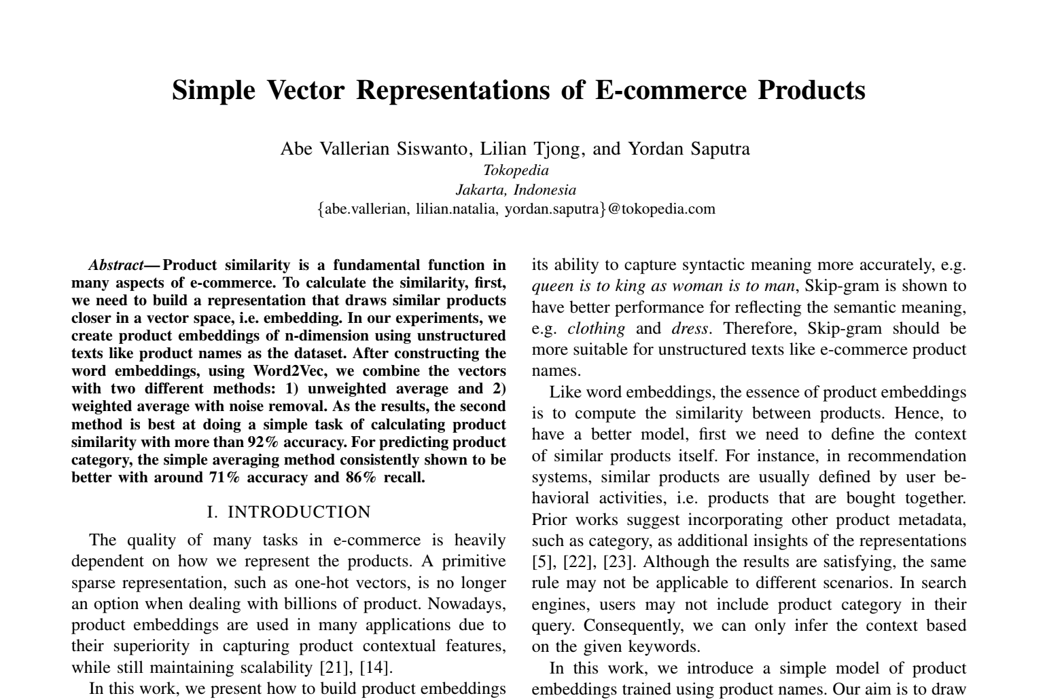

Publications
17 November 2018

Slide 5
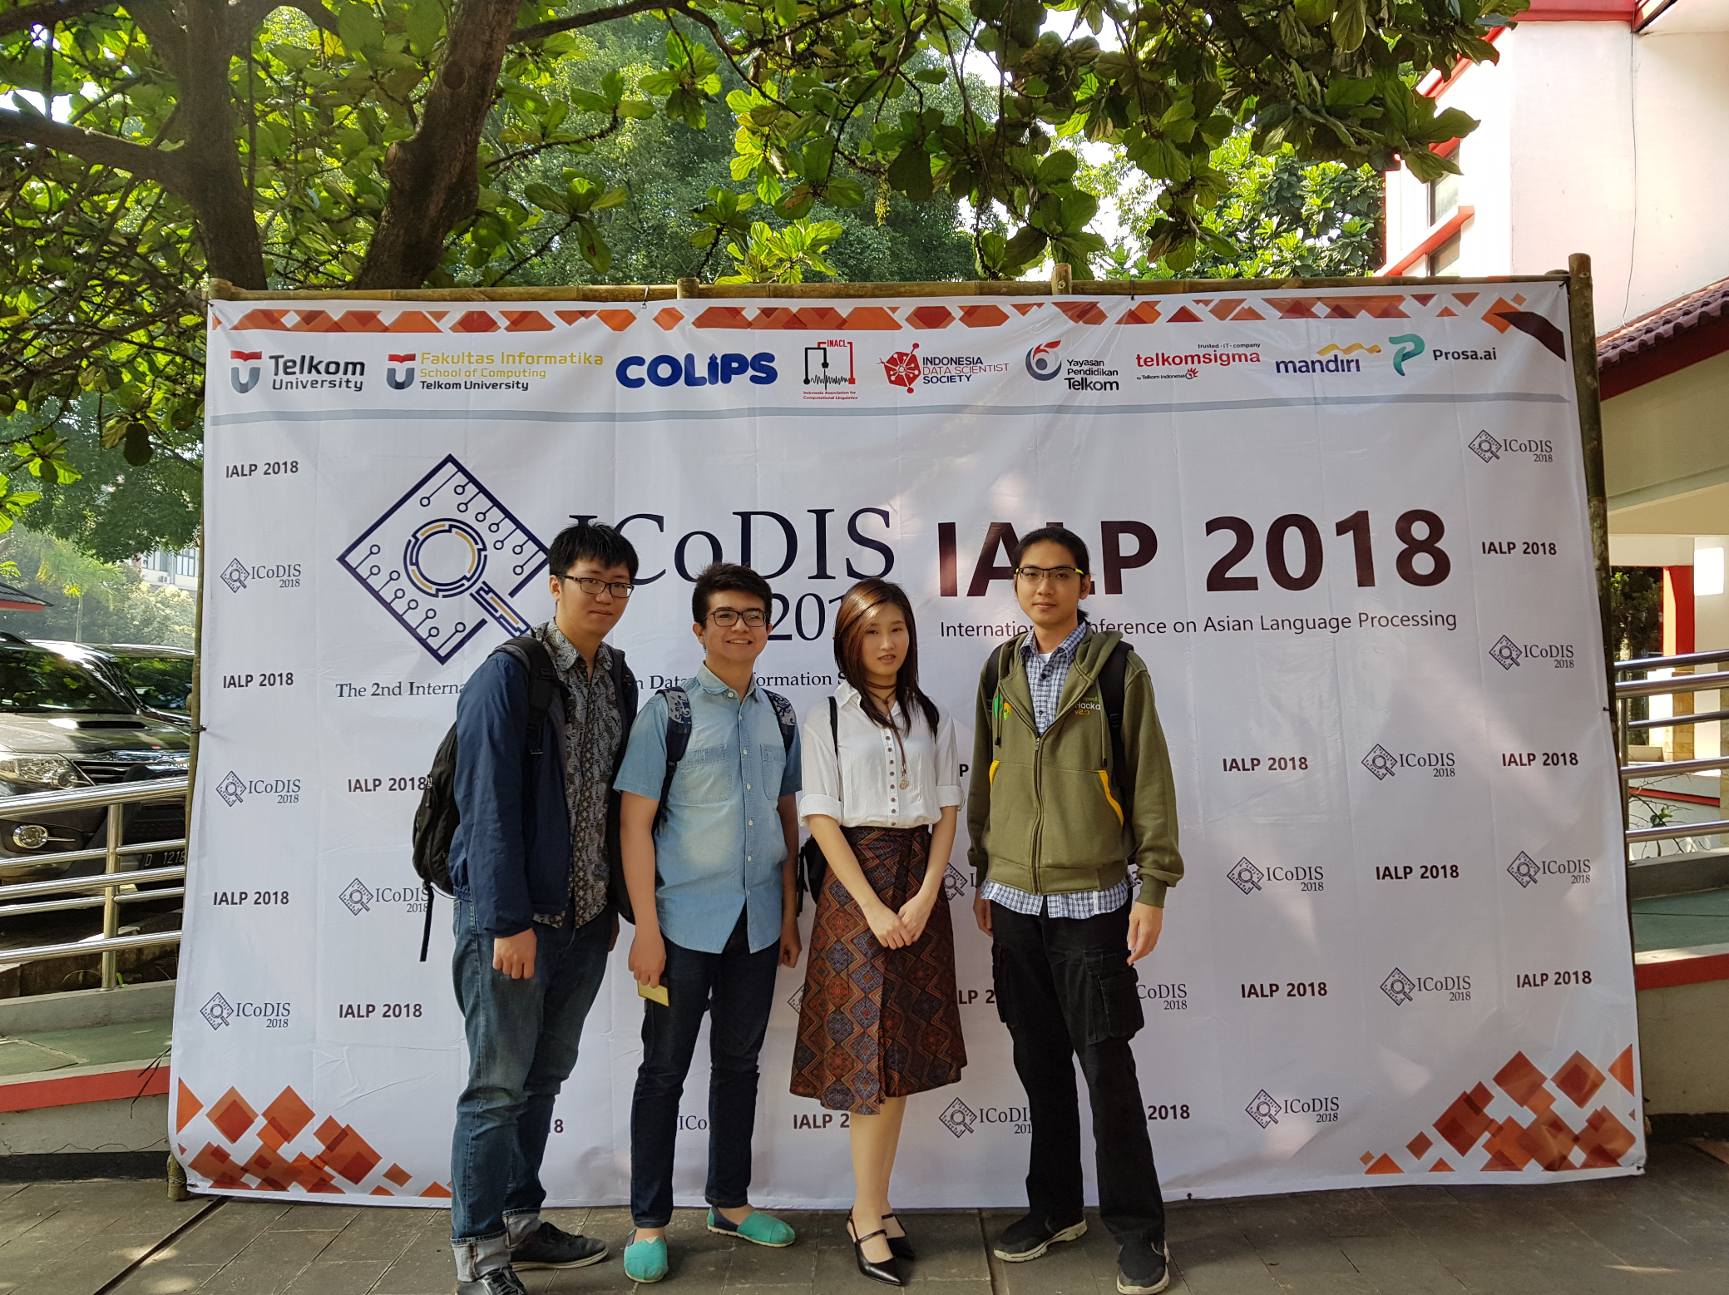
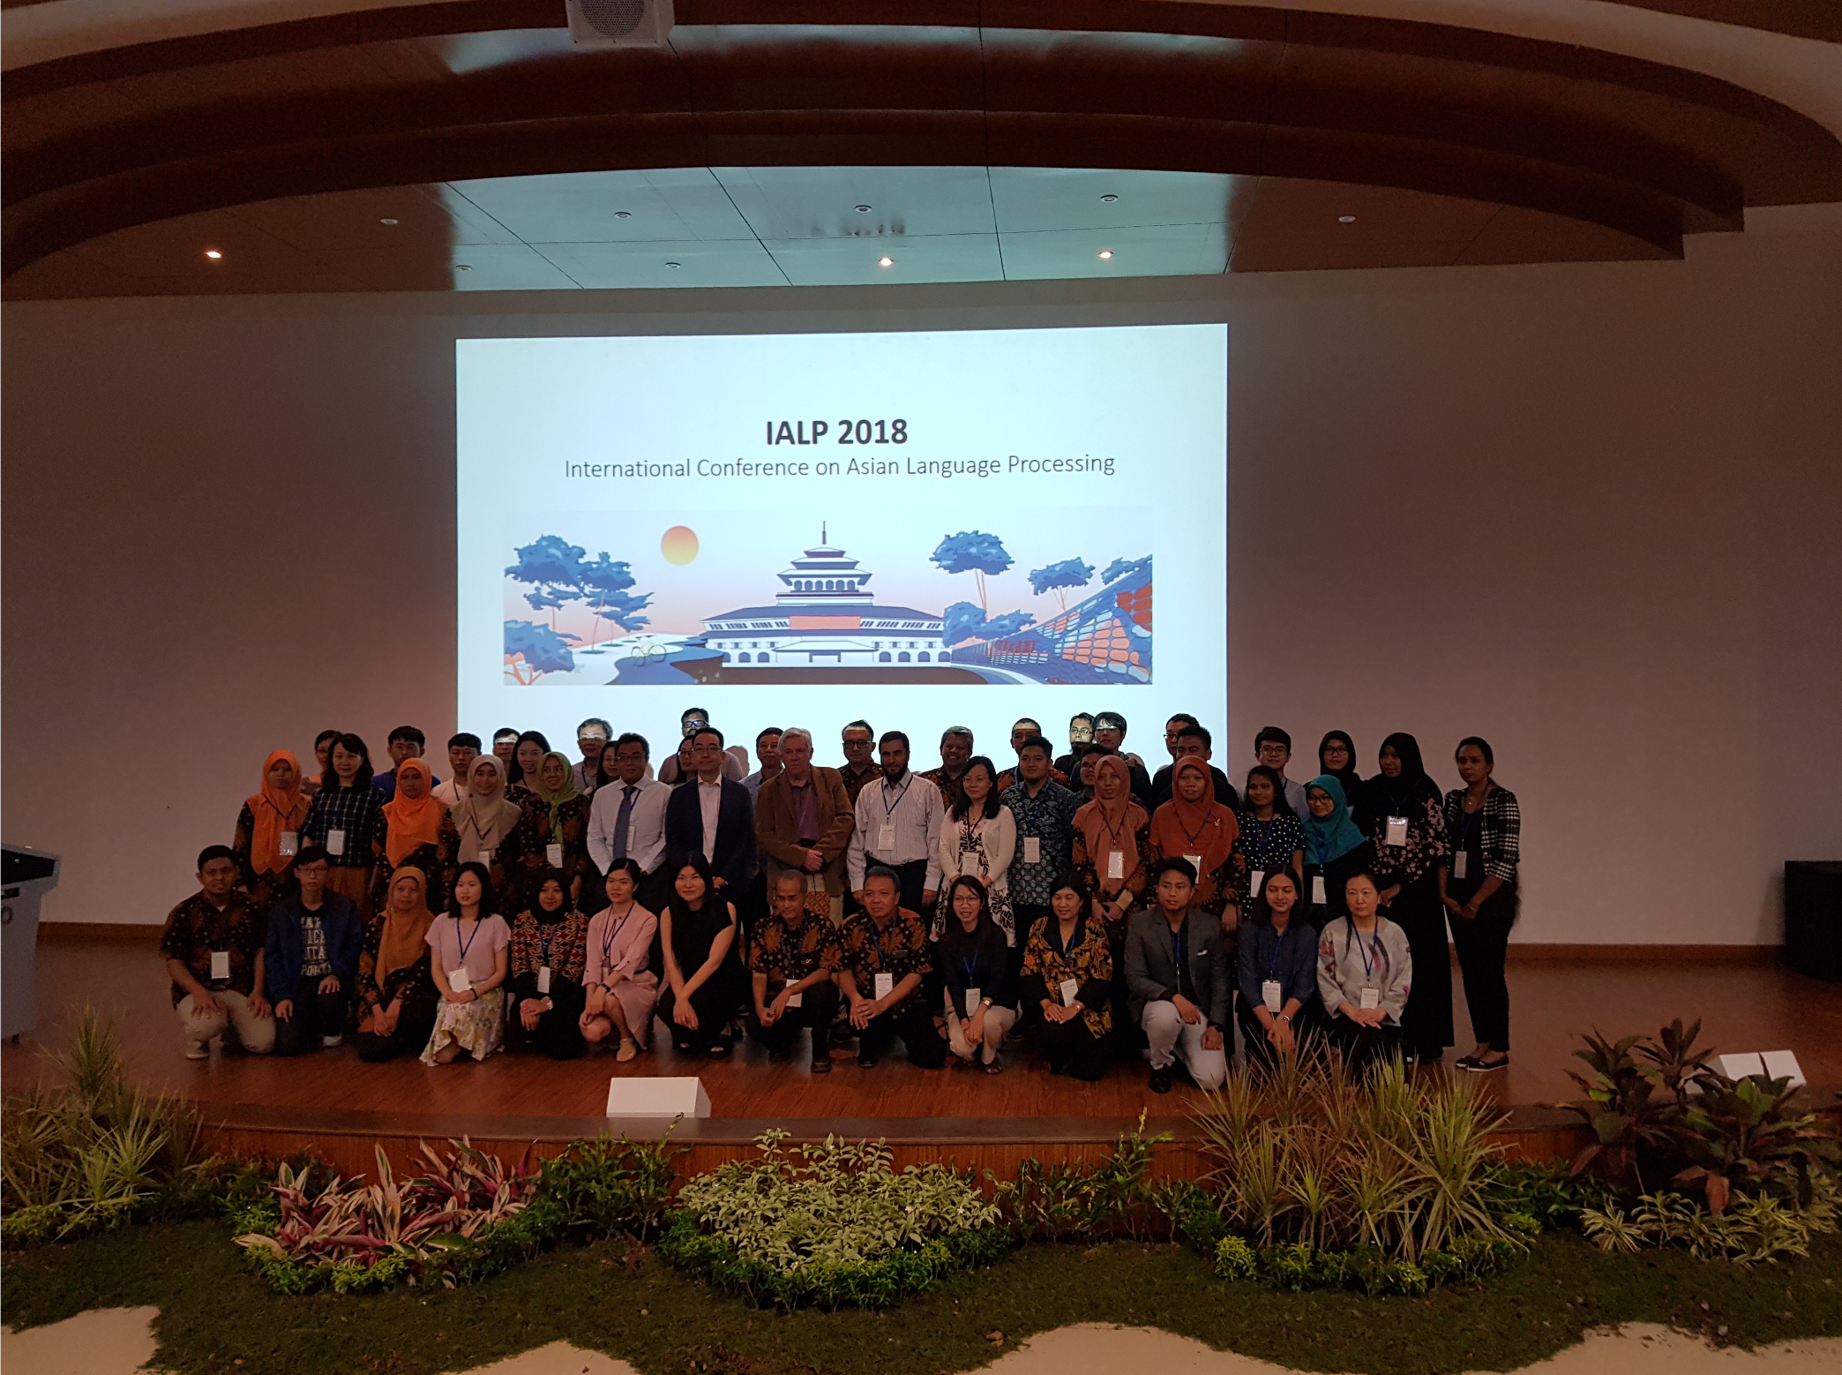
Publications
Lokasi: Telkom University, Bandung, Indonesia

Slide 6
Medium
https://medium.com/tokopedia-data-squad

Slide 7
What To Expect After Your Modelling?

Slide 8

Background story
Data products -- Wish and dream of company
https://www.her.ie/life/this-once-popular-name-for-baby-girls-is-on-the-verge-of-going-extinct-426571

Slide 9

Background story
Modelling
https://www.nytimes.com/2018/07/25/style/sperm-count.html

Slide 10
Background story

Slide 11
Background story

Slide 12
Background story
?

Slide 13
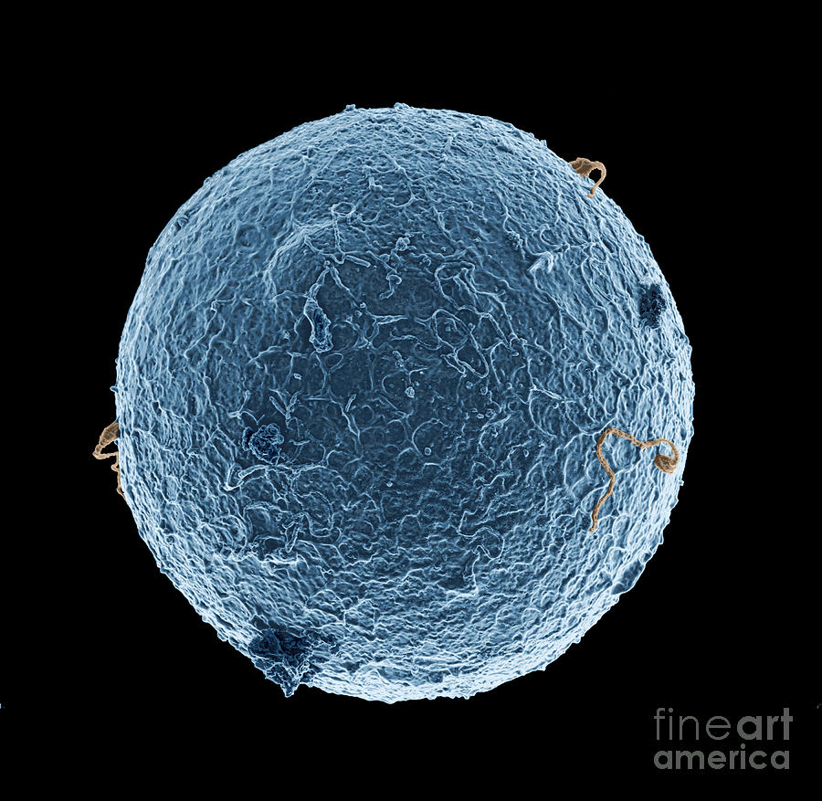
Background story
Modelling
Infrastructure
Should have focused on Infrastructure first.

Slide 14
Let’s say we have the model, what’s next?
Trigger to Action -- a must have for all projects
is a trigger definition for which, data scientist have to take actions.

Slide 15
Triggers
Actions
Daily?
Performance metrics?
Business metrics?
Score distribution?
Complains?
API usages?
….
….
Model re-evaluation
Model re-training
Termination
….
….

Slide 16
API Creation
Technical meet -- integration meeting (define API specification, etc.)
Model deployment

Slide 17
Deployment (API) - Tokopedia
We have 2 kinds of deployment:
Code/Handler deployment
Model deployment
Both types of deployment are done on top of our custom framework (built in house)

Slide 18
Code deployment
Data scientist will define:
API configurations -- inputs/outputs of API
Request handling

Slide 19
Model deployment
Data scientist will define:
Model validator/test
Submit model to Merlin -- to receive unique token for deployment
Put the token to our key/value storage for distribution to server swarms

Slide 20
That’s it.

Slide 21

Model and It’s Perspective
Mohammad Alfan Alfian Riyadi
(PIC Internal DSI East Java Chapter, Data Scientist at Warung Pintar)
Tokopedia Tower 52nd fl

Slide 22
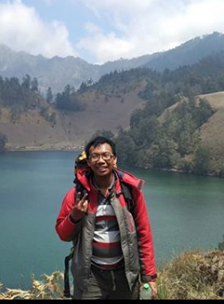


Short Bio
Education
- Bachelor Degree Statistics (2012-2016)
- Master Degree Statistics (2016-2018)
Activity
- PIC Internal DSI East Java Chapter
Working Experience
Sept 2018 - Now

Slide 23
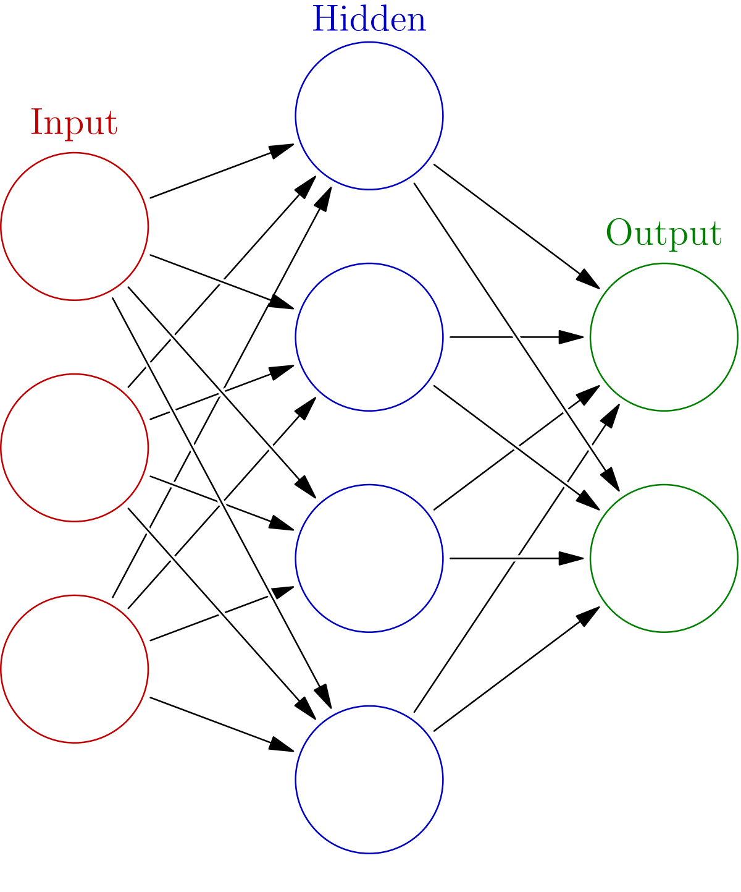

What is model?
Or?

Slide 24
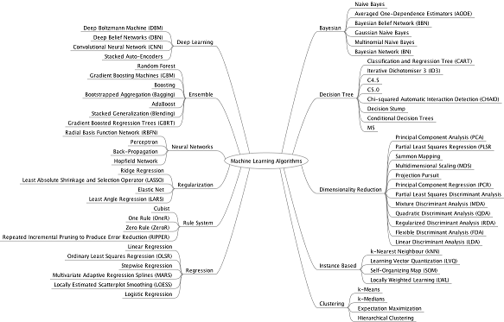

Slide 25
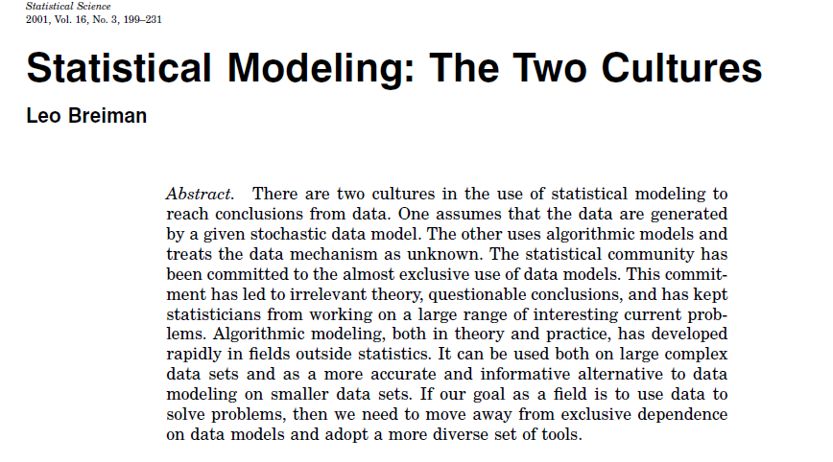

Slide 26
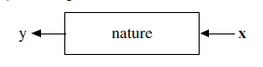
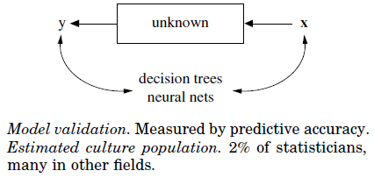
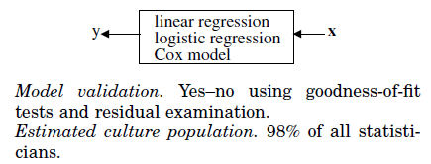
Model Culture
The Data Modeling Culture
The Algorithmic Modeling Culture

Slide 27
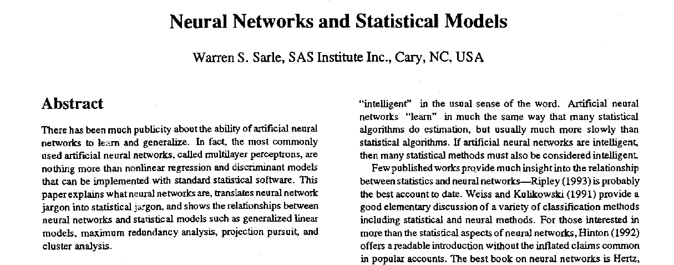

Slide 28
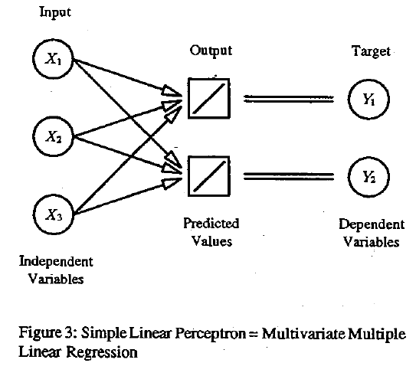
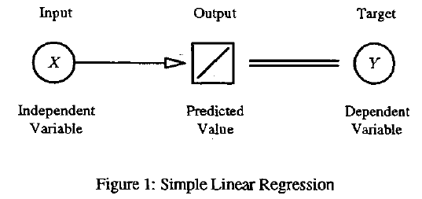

Slide 29
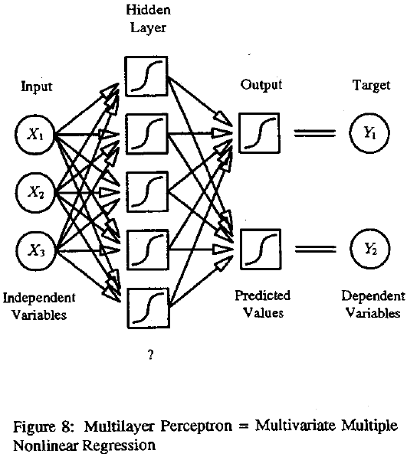
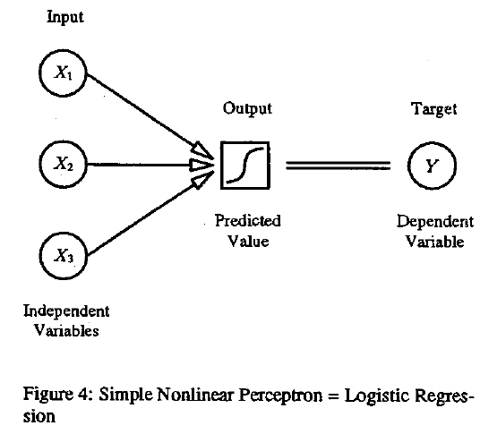

Slide 30
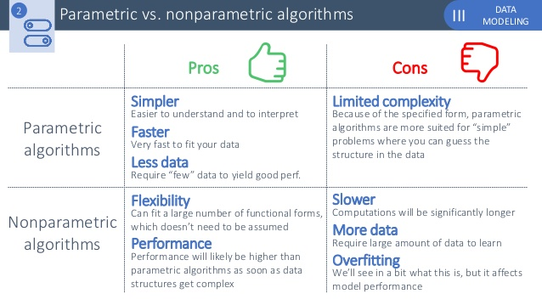
https://www.slideshare.net/CharlesVestur/building-a-performing-machine-learning-model-from-a-to-z

Slide 31
There is no such thing as “Best Algorithm”

Slide 32
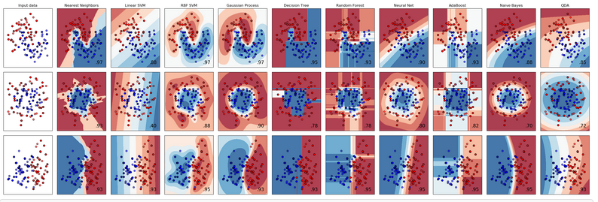
https://scikit-learn.org/stable/auto_examples/classification/plot_classifier_comparison.html

Slide 33
Back to your user
Information
or
Prediction
Parametric Model
Non- Parametric Model

Slide 34
Thank You
#Tumbuhbarengwarung

